Slide 1
Brown Spot Needle Blight In Loblolly Pine
Observational Infection Patterns and Potential Resistance
Al Lyons

Slide 2
Brown Spot Needle Blight in Loblolly Pine
Brown Spot Needle Blight (BSNB)
  Scientific Name: Lecanosticta acicola
    Other Scientific Name: Scirrhia acicola
BSNB Has Been well Known in the Southeast U.S. Since 1900
Primarily associated with longleaf pine but infects other pine:
  Loblolly pine
  Shortleaf pine
  Virginia pine
  Sondereggeri pine
  Pitch pine
  Eastern white pine
  Ponderosa pine
Source: Van Der Nest, Ariska et.al., Lecanostista acicula: A growing threat to expanding global pine forest and plantations (2019).

Slide 3
Brown Spot Needle Blight
Symptoms
  Small yellow irregular spots on needles that become brown
    May be surrounded by a yellow halo
  Brown spots form bands with needle death from infection to needle tip
  Infection usually more severe on lower part of tree and progresses upwards
  Identification based only on symptoms must be treated with caution and verified using molecular ID techniques
Dissemination
  Conidia and ascospores are released throughout the Year however, warm and wet weather is particularly conducive for development of BSNB
  Conidia are dispersed predominantly by rain splash to adjacent trees
  The main component that facilitates spread on conidia and ascospores is moisture
Genetic Resistance – Literature Review
  Breeding for resistance to L. acicula has been successfully used to reduce the impact of the disease on P. palustris in Alabama (Van Der Nest et. Al)
  Not all loblolly pine families are equally susceptible to brown spot (Alabama Extension)

Slide 4
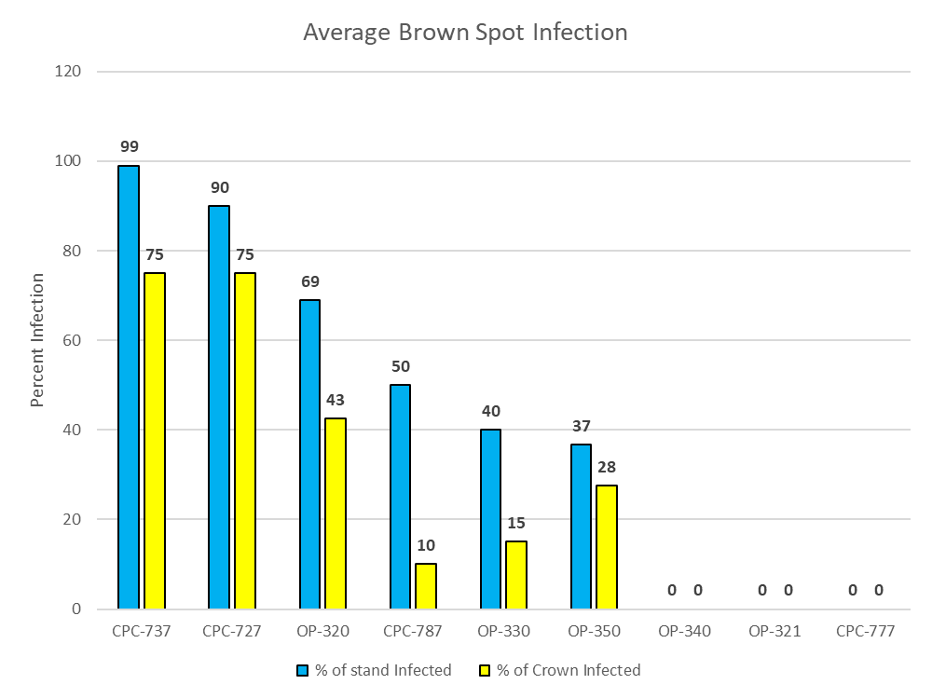
Observational Infection Patterns of BSNB
Loblolly Pine BCNB Infection Investigation Provided Antidotal Patterns of Resistance (Limited Data)
  Genetic Resistance by Family?
  Nutritional Resistance Influence?
  Age and/or Size Infection Pattern Difference?
Genetic Families are coded to avoid misconceptions due to potential observational errors
  CPC = Controlled Pollinated Cross
  OP = Open Pollinated

Slide 5
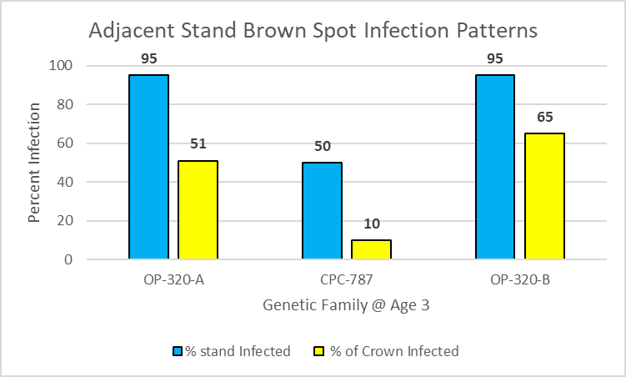
Genetic Resistance Pattern Evidence
Loblolly Pine Observational Genetic Resistance To Brown Spot

Slide 6
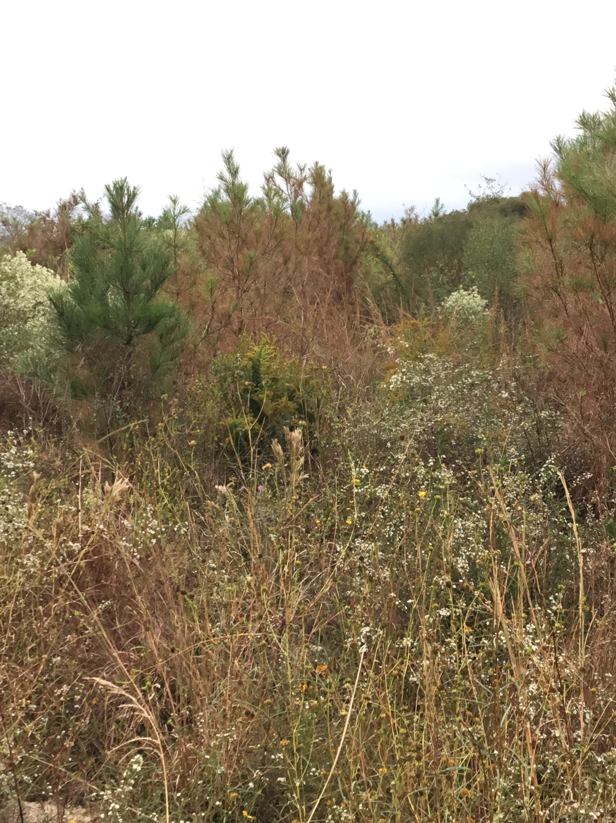
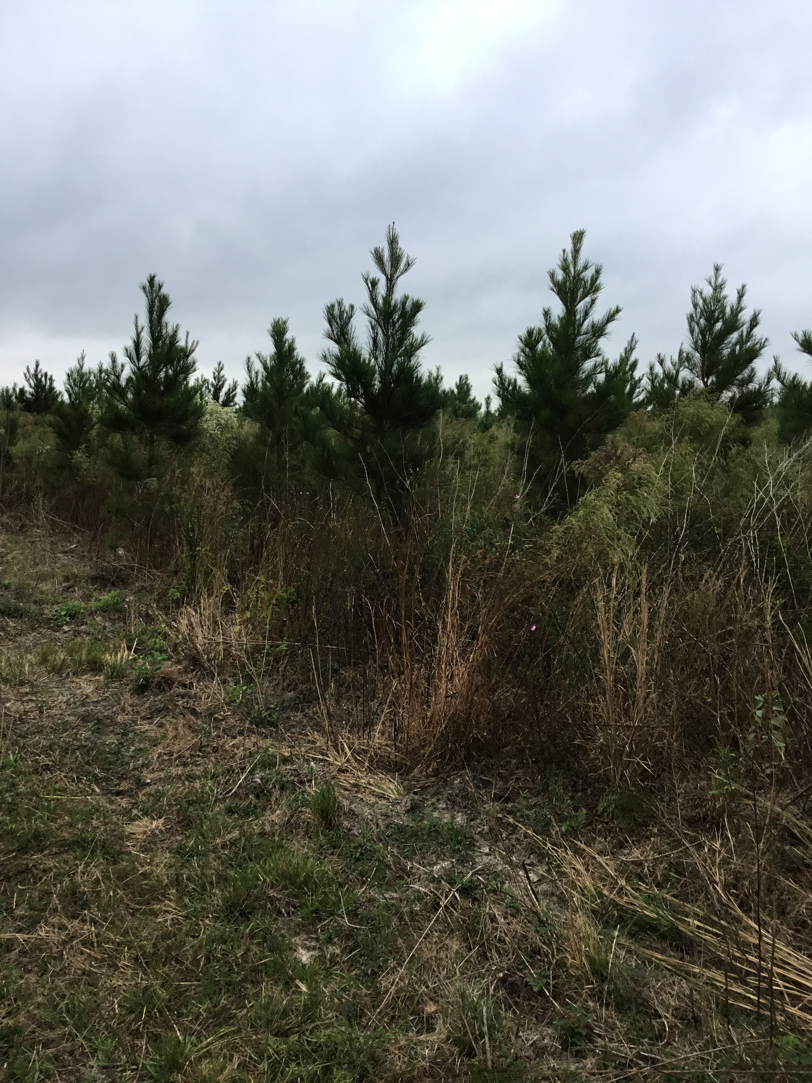
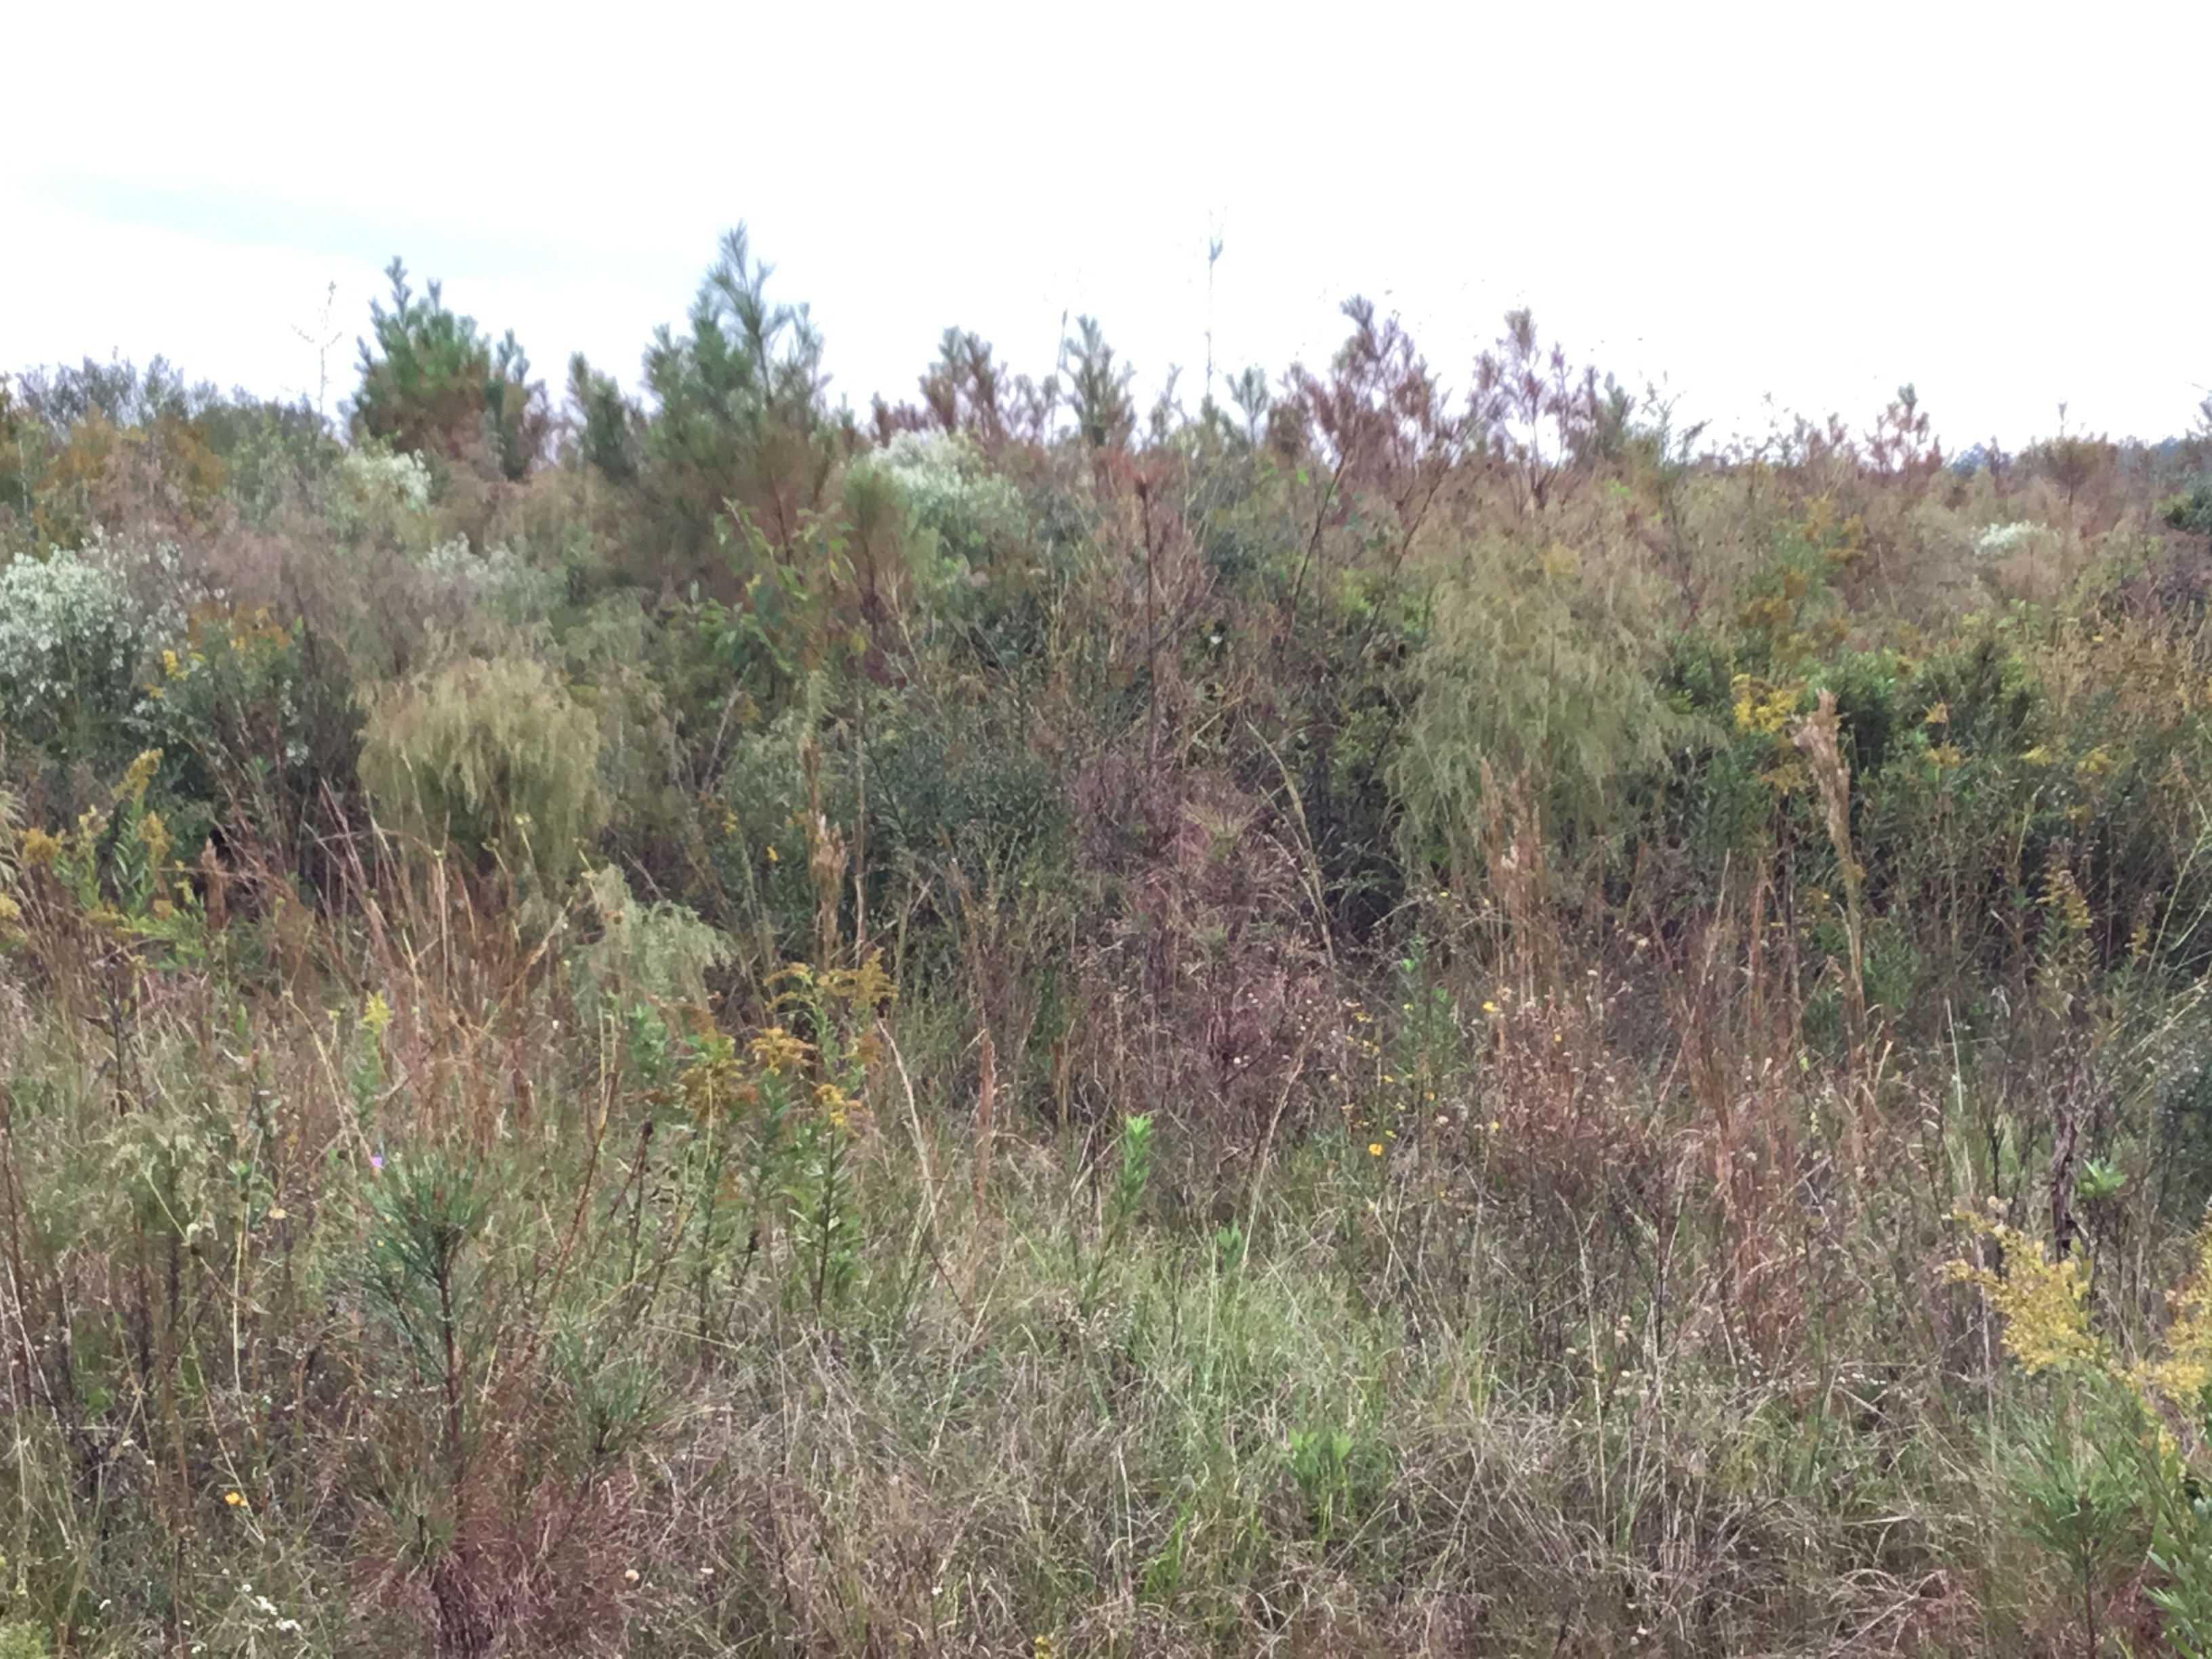
Genetic Resistance Patterns – Observational Evidence
Age 3 Loblolly Pine Plantation
Family OP-320,
Sub-stand A
Family CPC-787,
Sub-stand B
Family OP-320,
Sub-stand C

Slide 7
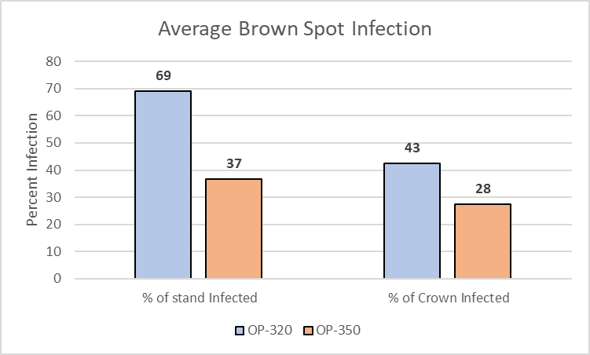
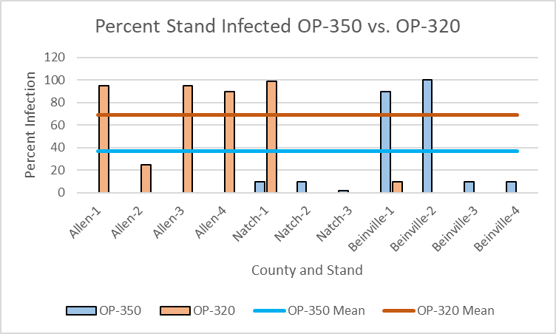
Genetic Resistance Pattern – Observational Evidence

Slide 8
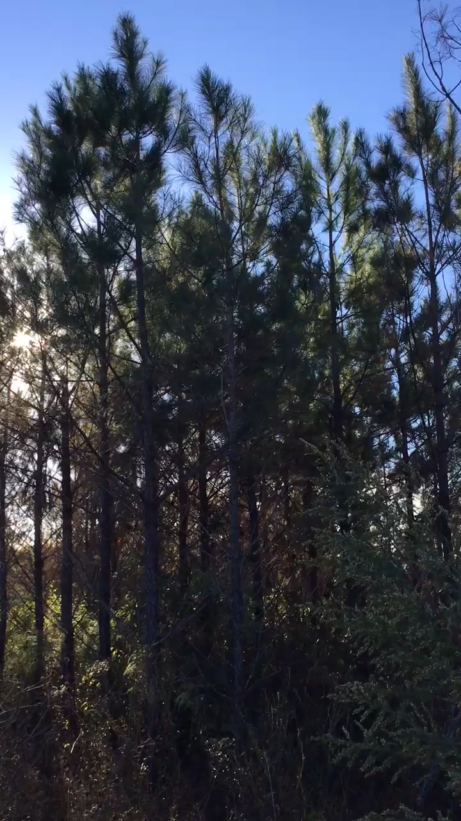
Nutritional or Age Resistance Pattern – Observational Evidence

Slide 9
Brown Spot Foliar Nutrient Levels

Slide 10
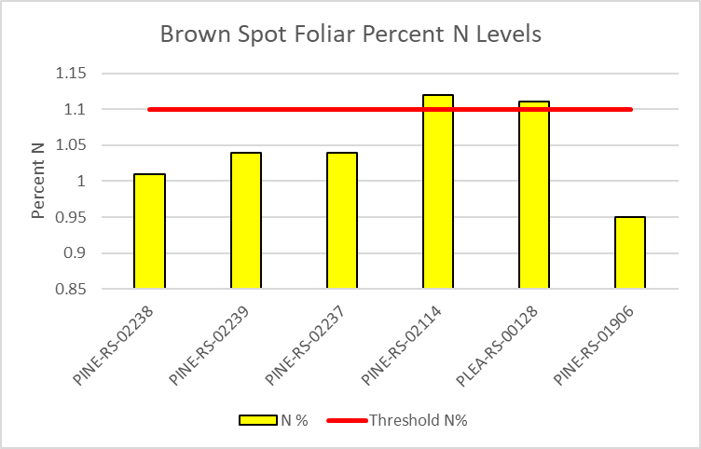
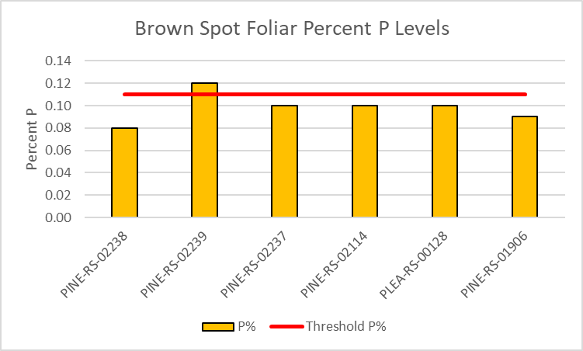
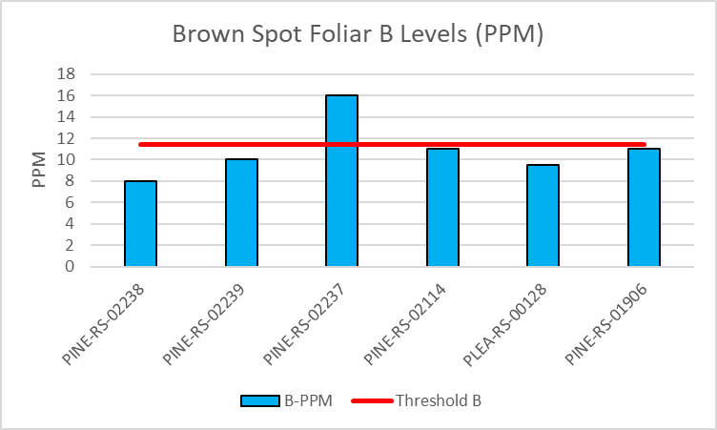
Brown Spot Foliar Nutrient Levels

Slide 11
Brown Spot Needle Blight
Discussion:
  BSNB on loblolly pine has been reported across the Southeast
  Is BSNB a big enough concern to have the Tree Improvement Co-Ops look at genetic resistance patterns?
  Should the Tree Improvement Co-ops collaborate with Auburn and University of Georgia forest health programs to develop management strategies?

